Slide 1
Summary
Problem/Hypothesis
How
High-level conclusion

Slide 2
Background
Other studies on gentrification
Stage Theory
People, Policy, Place
Model neighborhoods

Slide 3
Emmy
our approach
construct an accurate snapshot of NYC neighborhoods
explore growth trends by neighborhood
develop a method to rank investment worthiness
evaluate the effectiveness of each method

Slide 4
Emmy
the variables
people
place
policy
income & crime
sales & development
opportunity zone
IRS NYPD
DOF DOB
NY ESD

Slide 5
Michana
Data Exploration
Income – IRS
- year,s
Sales –
Dev
A

Slide 6
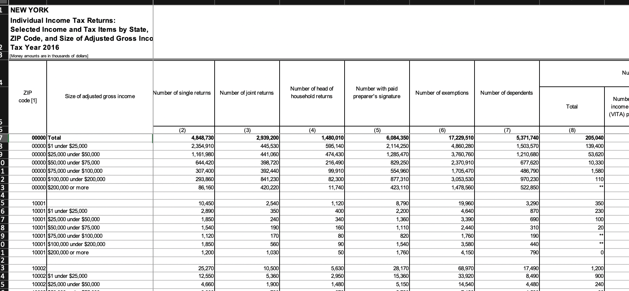
Crime - Michana
Data Clean Up
Before and After
Tell the transformation story

Slide 7
Emmy
our data -> sales
80 spreadsheets
2003 – 2018 sales data by year and borough
1 SQL database
loaded all spreadsheets into pgAdmin
5 csv files
export data by borough

Slide 8
Sales and Dev - Emmy
Data Clean Up
Before and After
Tell the transformation story

Slide 9
JC - Income
our data -> income
file names
title rows
1 df
nuanced nulls
ZIP
ZIP- neighbor-hood
column orders
column names
merged cells
inconsistent
missing pk
normalized

Slide 10
JC – Opp Zone
our data -> opportunity zone
tabula py
clean up
normalized

Slide 11
???
Coding for Model

Slide 12
All
our data visualized

Slide 13
All – but one slide
Hypothesis
Conclusion

Slide 14
JC
Limitations
Recommendations

Slide 15
Q&A

